Slide 1

CORONA VIRUS
ANALYSIS WITH SQL
BY: KHUSHI KADD
PROFILE: DATA ANALYST INTERN
BATCH NAME: MIP-DA-07

Slide 2
The CORONA VIRUS pandemic has had a significant impact on public health and has created an urgent need for data-driven insights to understand the spread of the virus. As a data analyst, you have been tasked with analyzing a CORONA VIRUS dataset to derive meaningful insights and present your findings.

Slide 3
DATASET
Description of each column in dataset:
Province: Geographic subdivision within a country/region.
Country/Region: Geographic entity where data is recorded.
Latitude: North-south position on Earth's surface.
Longitude: East-west position on Earth's surface.
Date: Recorded date of CORONA VIRUS data.
Confirmed: Number of diagnosed CORONA VIRUS cases.
Deaths: Number of CORONA VIRUS related deaths.
Recovered: Number of recovered CORONA VIRUS cases.

Slide 4
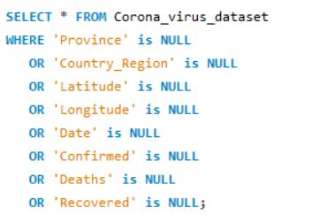
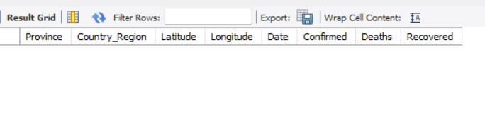
SQL Query
Q1. Write a code to check NULL values
Result

Slide 5
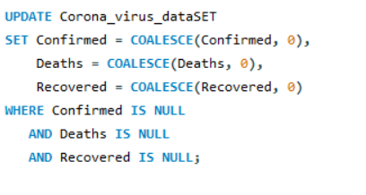
SQL Query
Q2. If NULL values are present, update them
with zeros for all columns.
Result
No NULL Values present

Slide 6
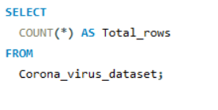
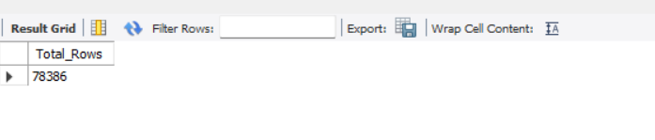
SQL Query
Q3. Check total number of rows
Result

Slide 7
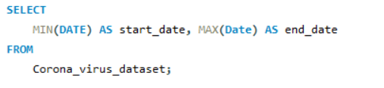
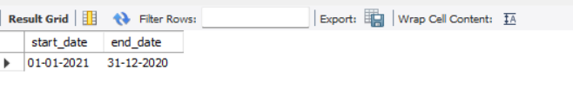
SQL Query
Q4. Check what is start_date and end_date
Result

Slide 8
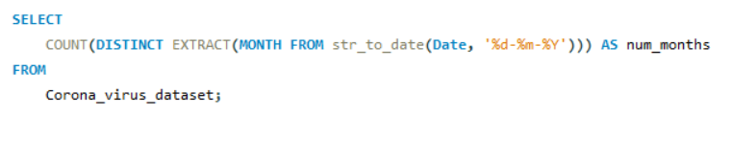
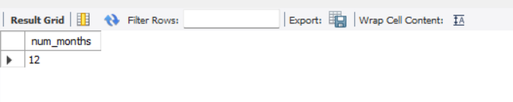
SQL Query
Q5. Number of month
present in dataset
Result

Slide 9
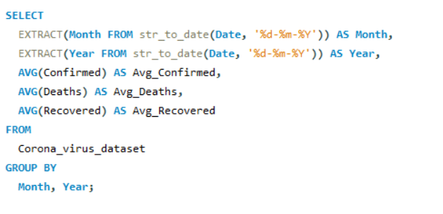
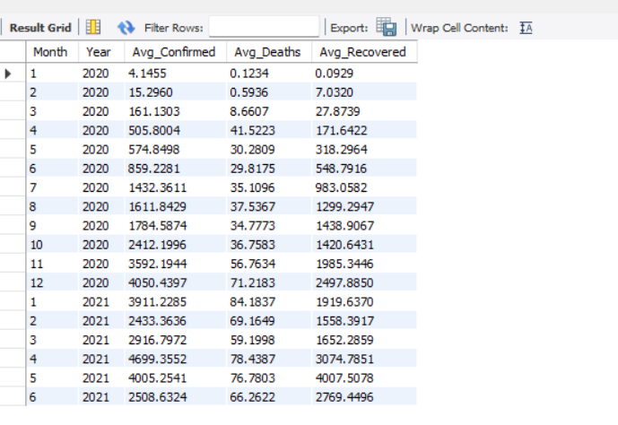
SQL Query
Q6. Find monthly average for confirmed,
deaths, recovered
Result

Slide 10
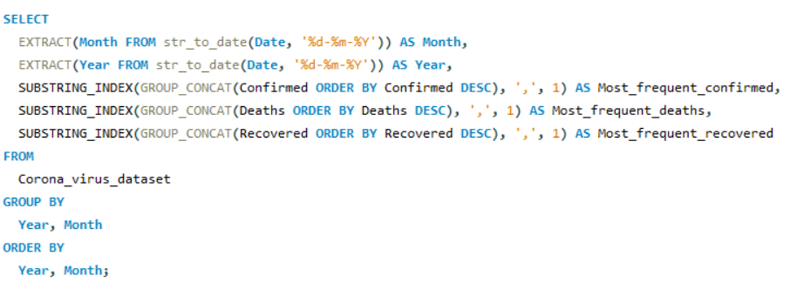
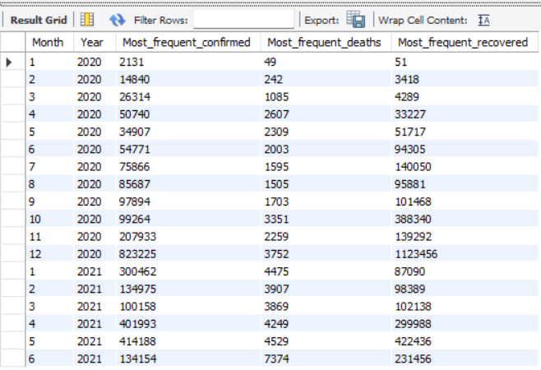
SQL Query
Q7. Find most frequent value for confirmed,
deaths, recovered each month
Result

Slide 11
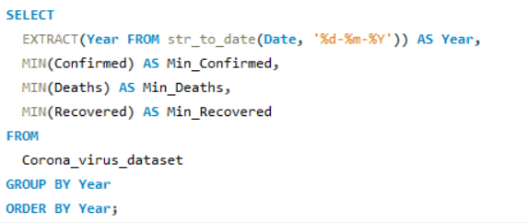
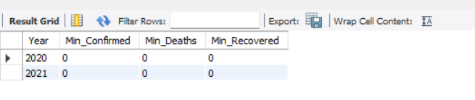
SQL Query
Q8. Find minimum values for confirmed,
deaths, recovered per year
Result

Slide 12
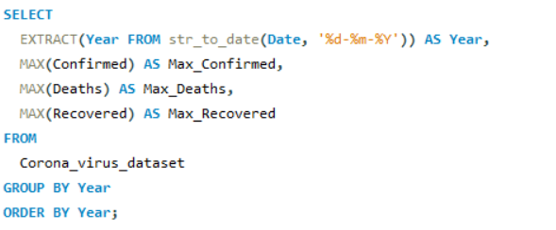
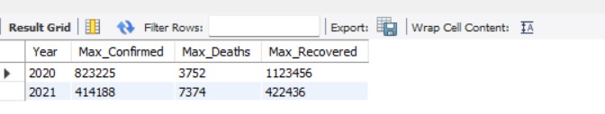
SQL Query
Q9. Find maximum values of confirmed,
deaths, recovered per year
Result

Slide 13
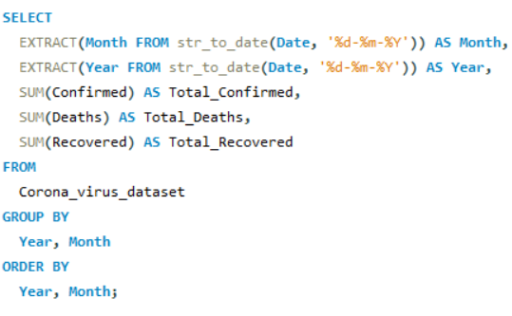
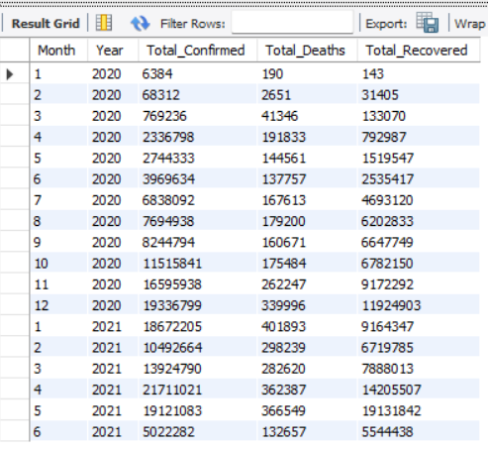
SQL Query
Q10. The total number of case of confirmed,
deaths, recovered each month
Result

Slide 14
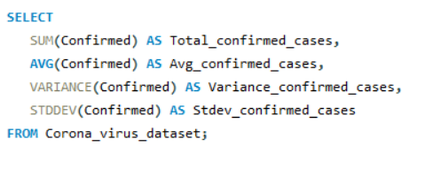
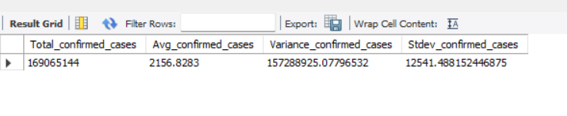
SQL Query
Q11. Check how corona virus spread out
with respect to confirmed case
(Eg.: total confirmed cases, their average,
variance & STDEV )
Result

Slide 15
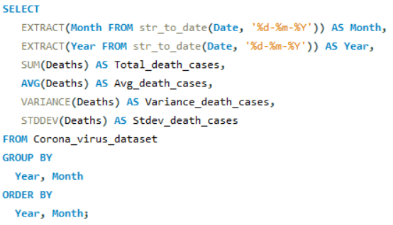
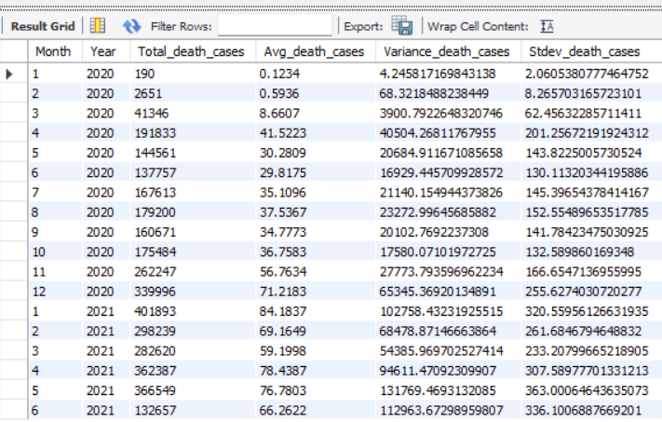
SQL Query
Q12. Check how corona virus spread out
with respect to death case per
month (Eg.: total confirmed cases,
their average, variance & STDEV )
Result

Slide 16
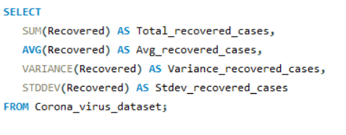
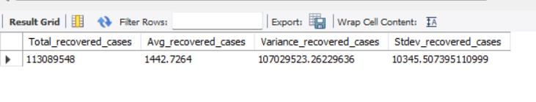
SQL Query
Q13. Check how corona virus spread out
with respect to recovered case
(Eg.: total confirmed cases,
their average, variance &
STDEV )
Result

Slide 17
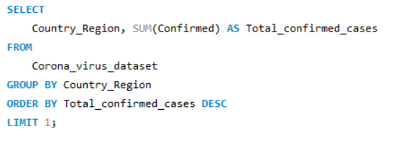
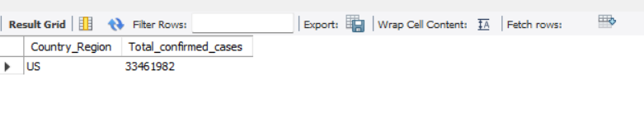
SQL Query
Q14. Find Country having highest number
of the Confirmed case
Result

Slide 18
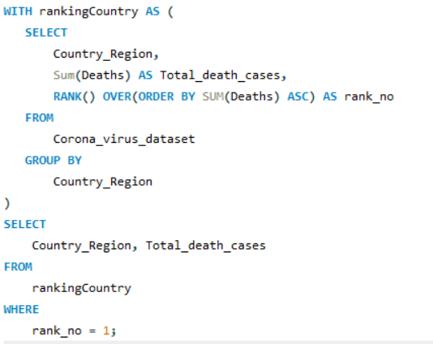
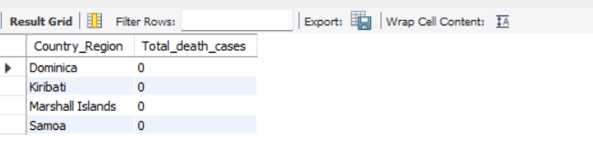
SQL Query
Q15. Find Country having lowest number of
the death case
Result

Slide 19
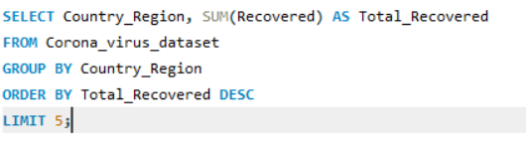
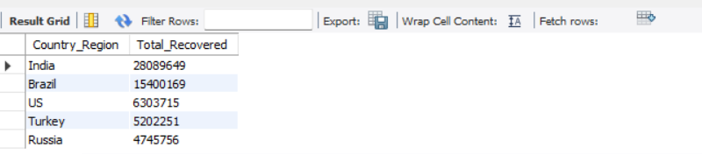
SQL Query
Q16. Find top 5 countries having
highest recovered case
Result

Slide 20
THANK YOU!!!

